Slide 1
Material Identification
Image Classification
Tim Fuger
March, 2023

Slide 2
Project objective
To develop a Convolutional Neural Network that can properly identify material types for warehouse and scrap material handling at Madjek Inc.
Notes:
Explain a convolutional neural network, type of model that a data scientist can use that works well in image classification

Slide 3


Project objective
Reduce time in material handling processing
Reduce human error in material handling
Notes:
Objective to result in the following
Not required to input material manually into a screen
Machines are predictable and can be trained to get it right.
<a href="https://www.flaticon.com/free-icons/human-error" title="human error icons">Human error icons created by Parzival’ 1997 - Flaticon</a>
<a href="https://www.flaticon.com/free-icons/down-time" title="down time icons">Down time icons created by Freepik - Flaticon</a>

Slide 4



Project objective
Receiving Material from suppliers
Storing Scrap in racks
Quality Control check at machines
Notes:
Parent objective implemented in 3 work intervals throughout the organization

Slide 5
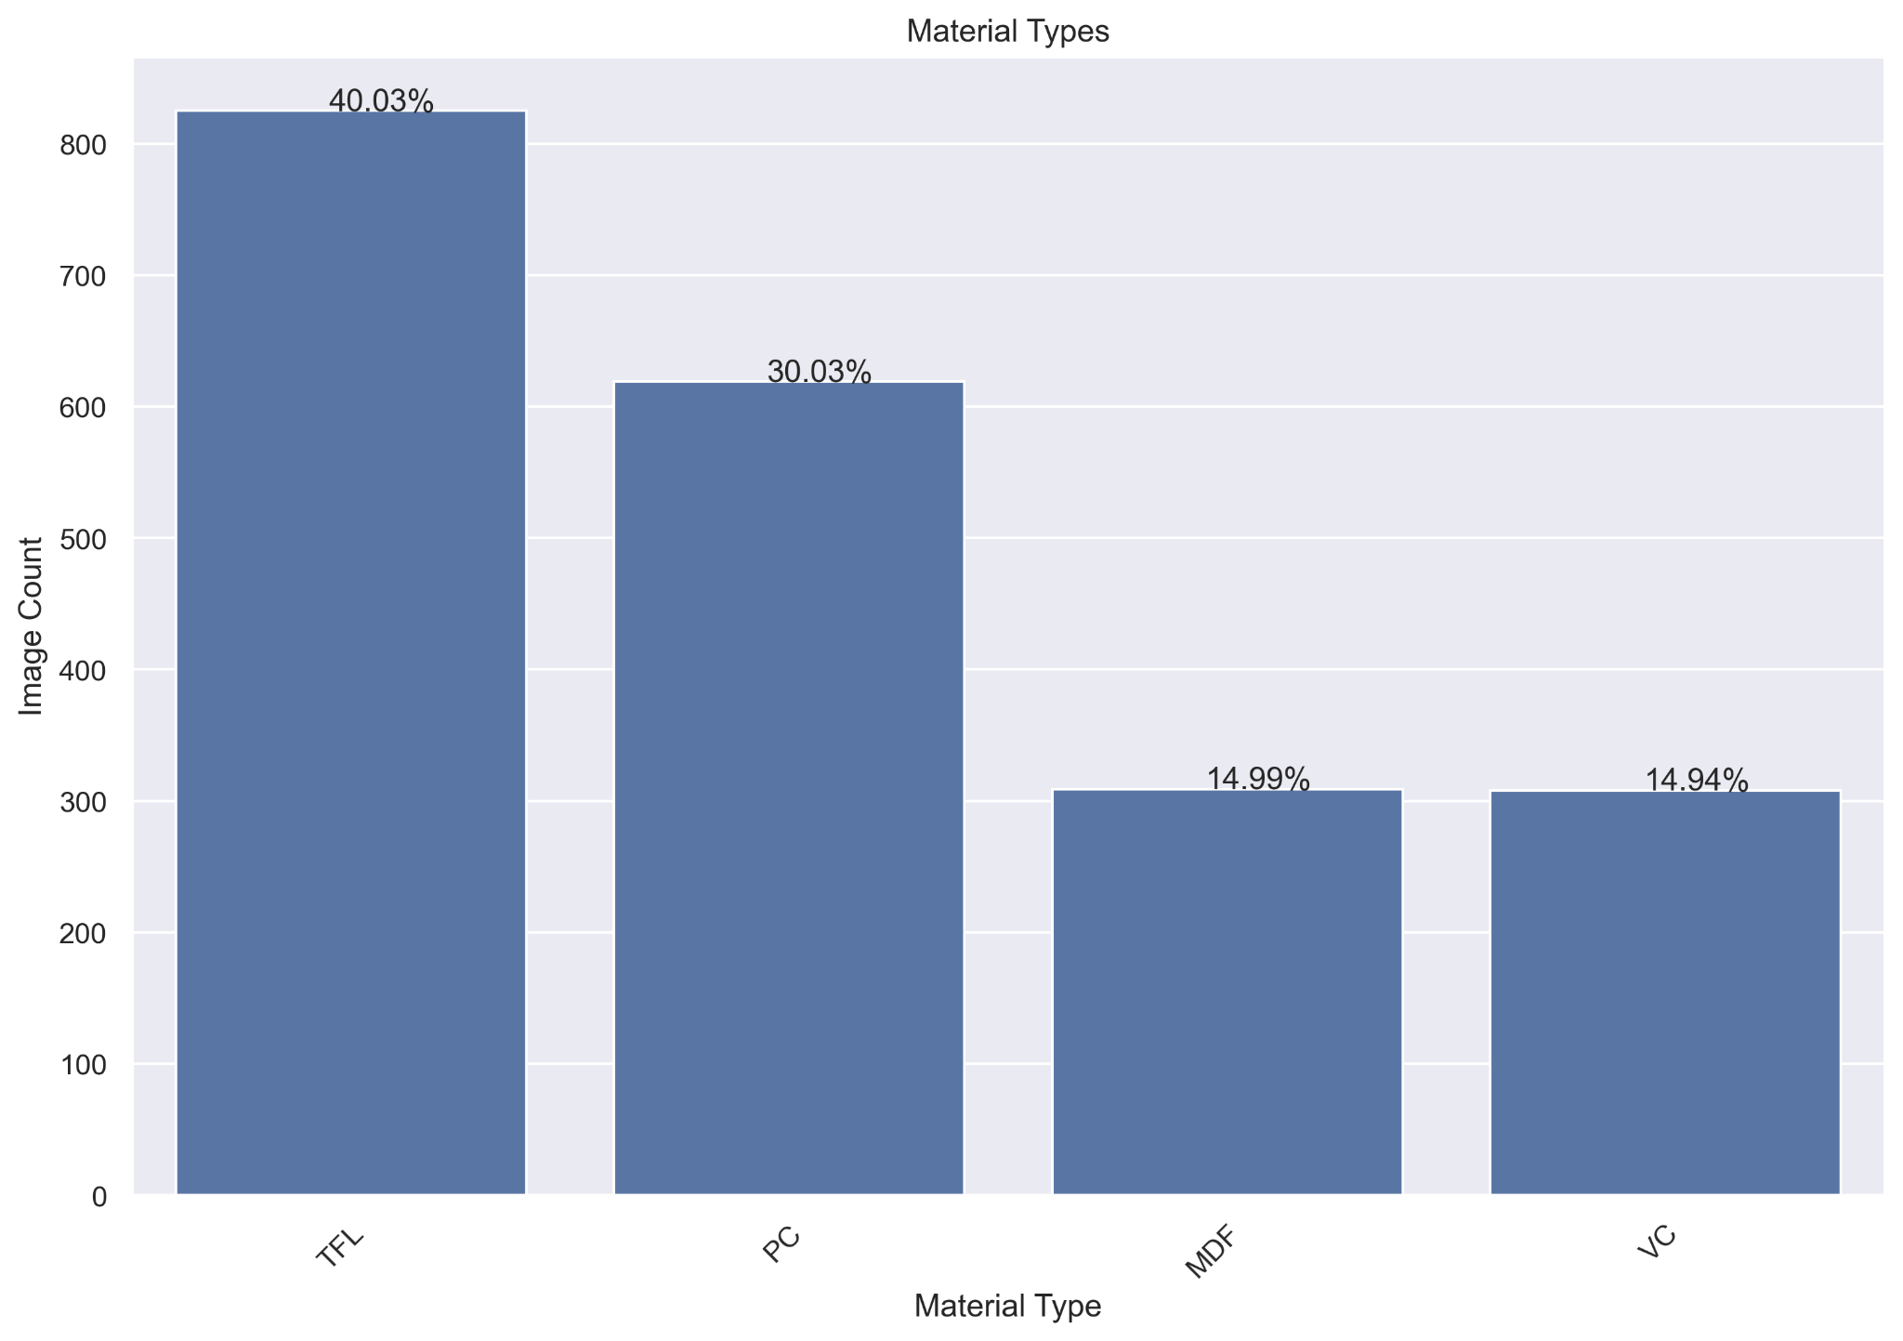
Data
2064 images in total, divided into 4 classes
TFL and PC are the most common images as they are the most common materials used in the factory
Notes:
Image data collected on a iphone 13 over one day period
Explain each class

Slide 6
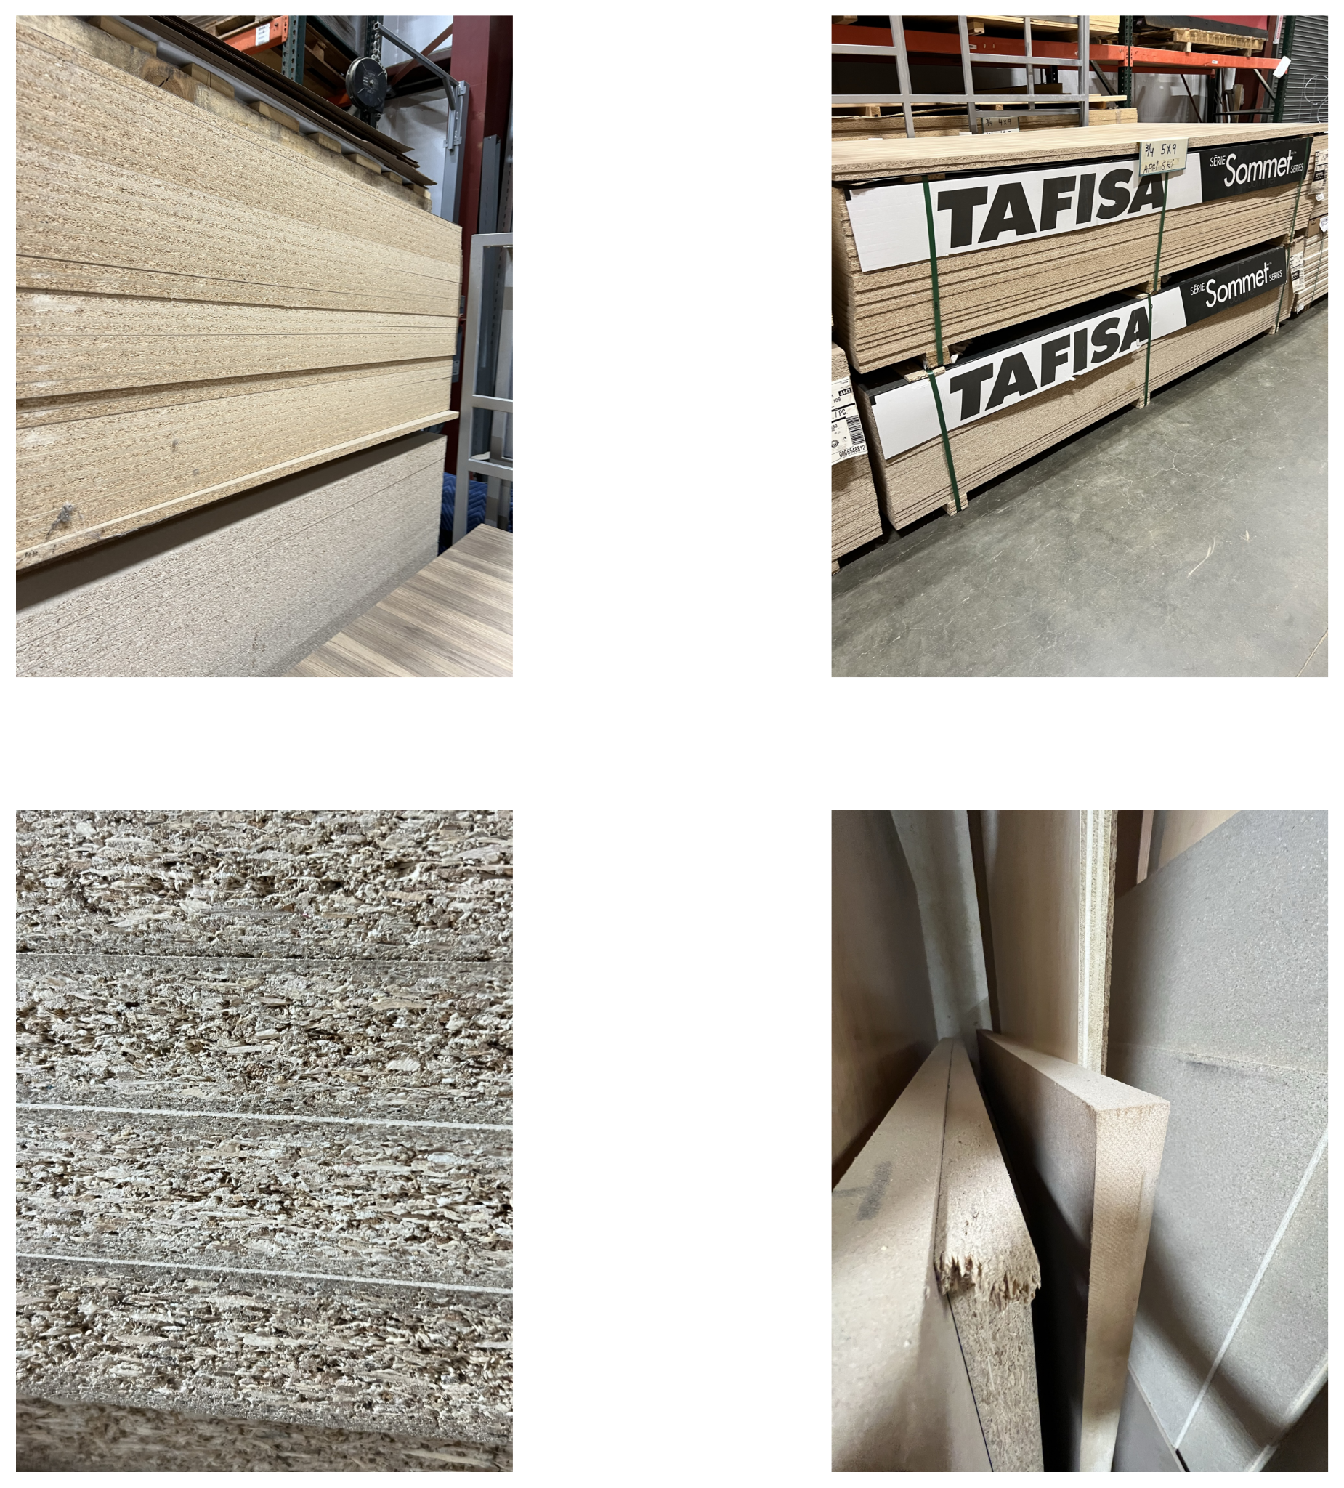
Data Collection
Images taken from a variety of viewpoints in varied lighting conditions
Human identified class of material centered in each image
Notes:
Images taken over the course of one day at the facility.

Slide 7
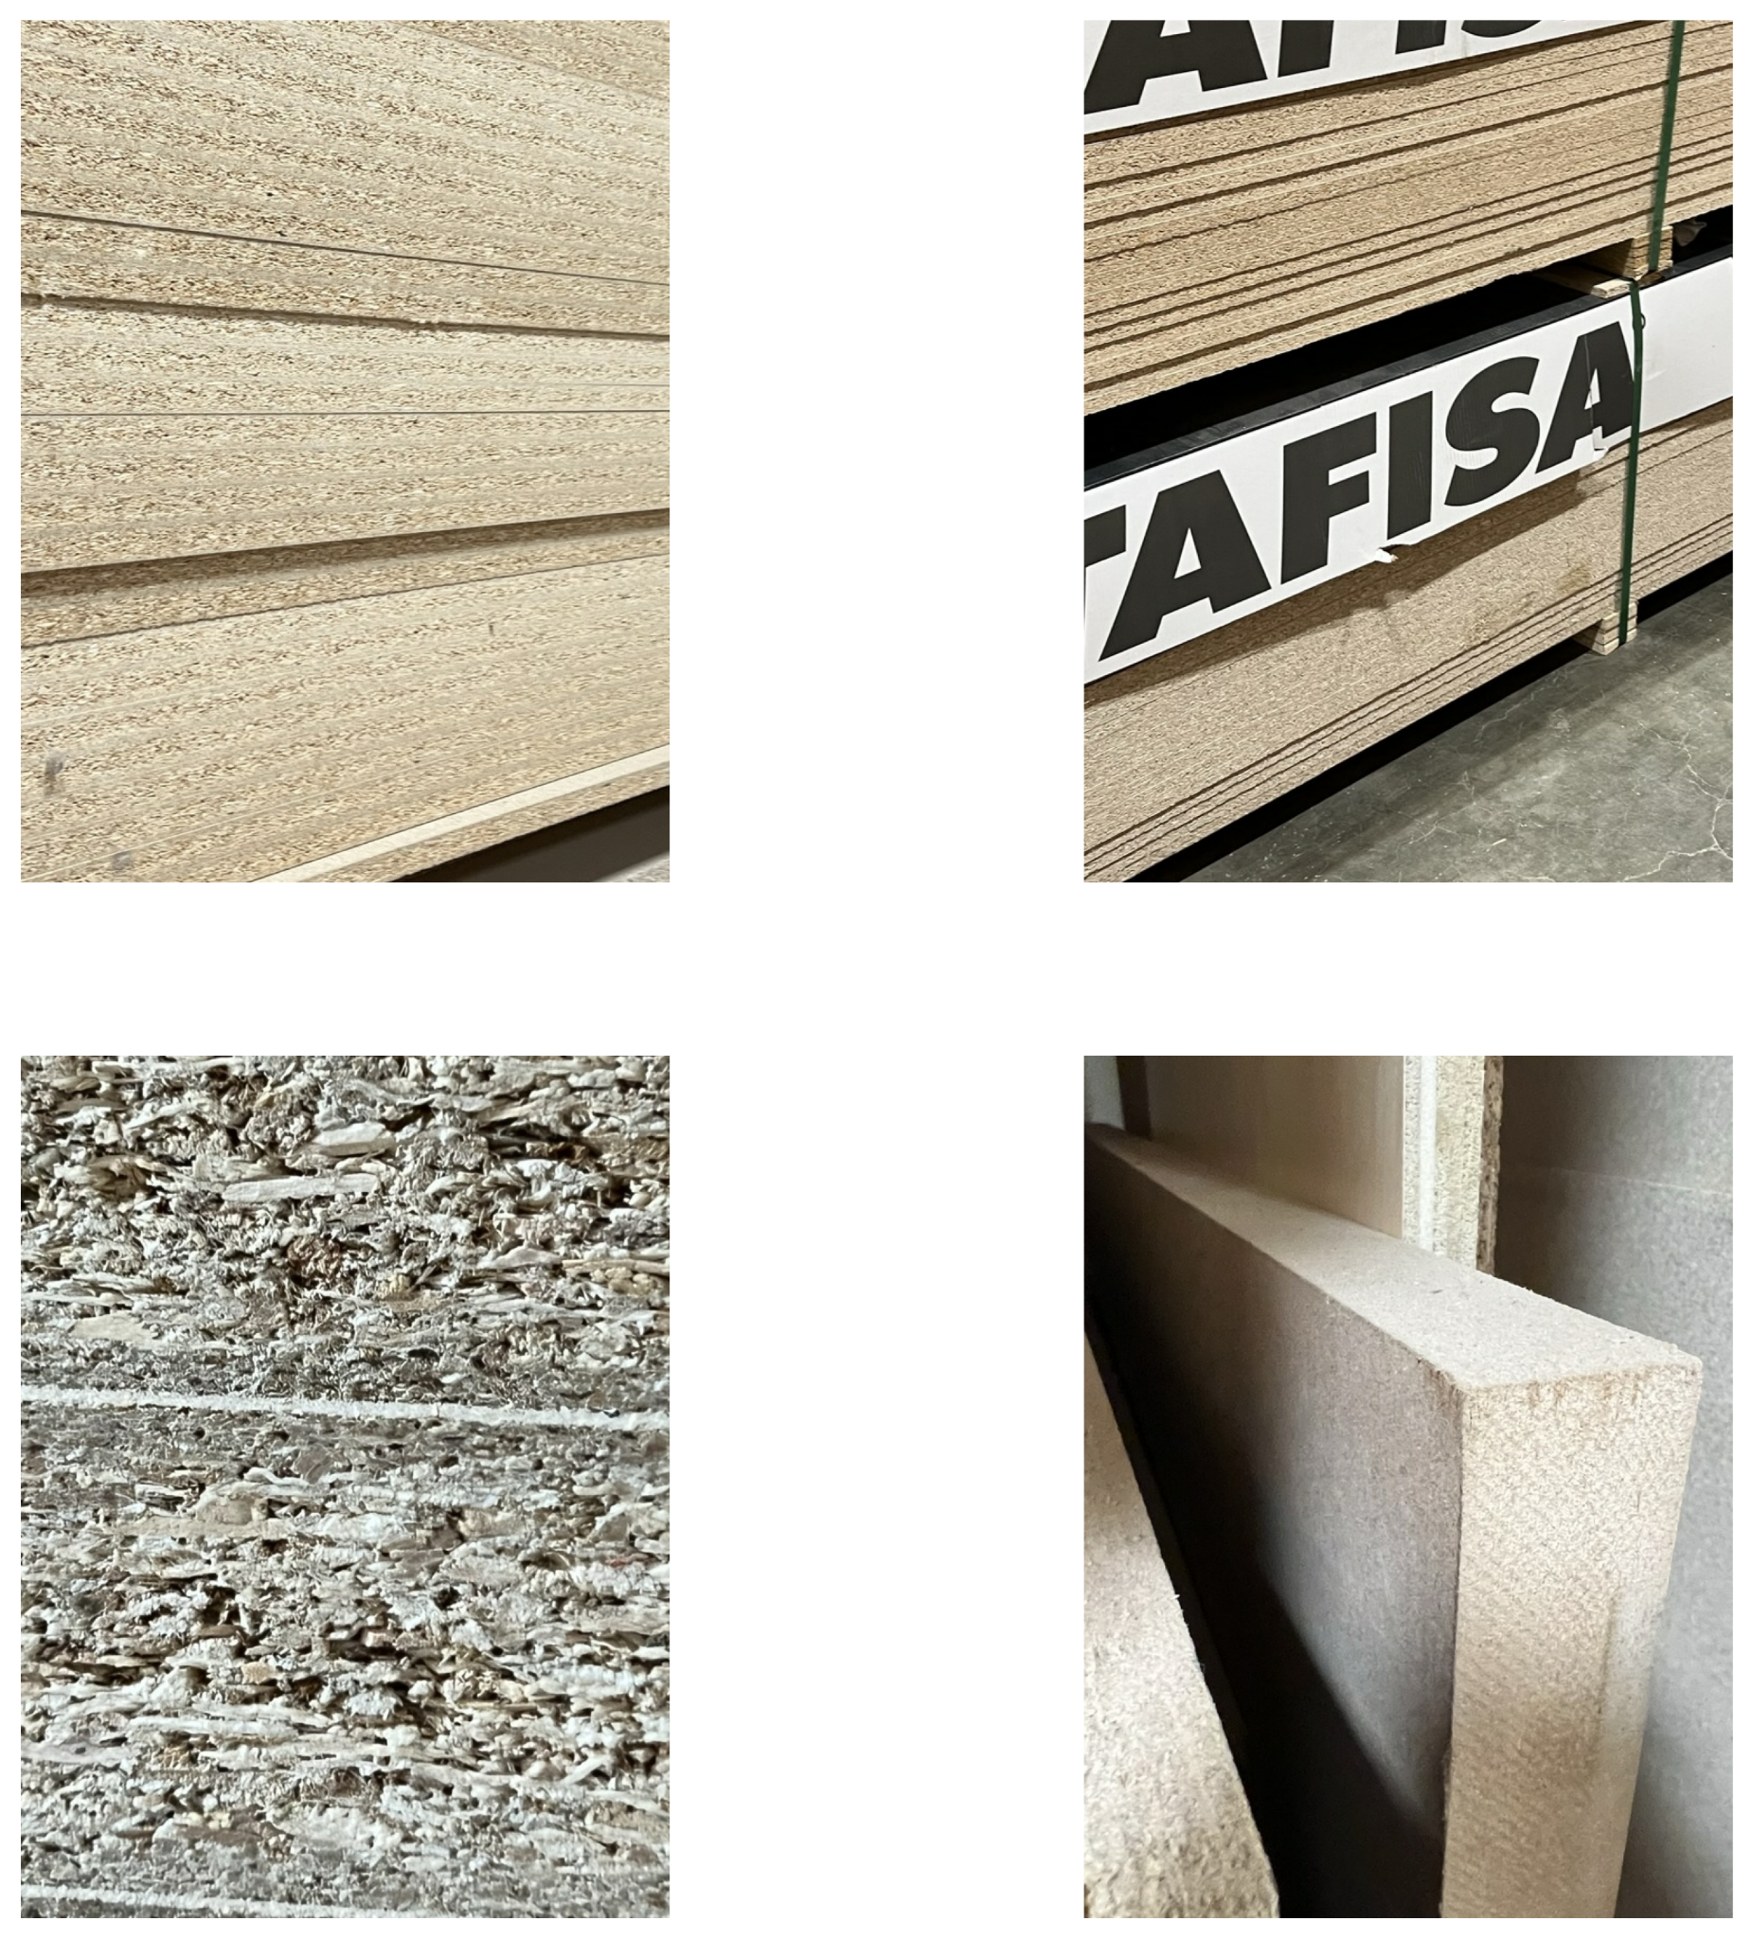
Data Collection - Cropped
Images taken from a variety of viewpoints in varied lighting conditions
Human identified class of material centered in each image
Notes:
Images taken over the course of one day at the facility.

Slide 8
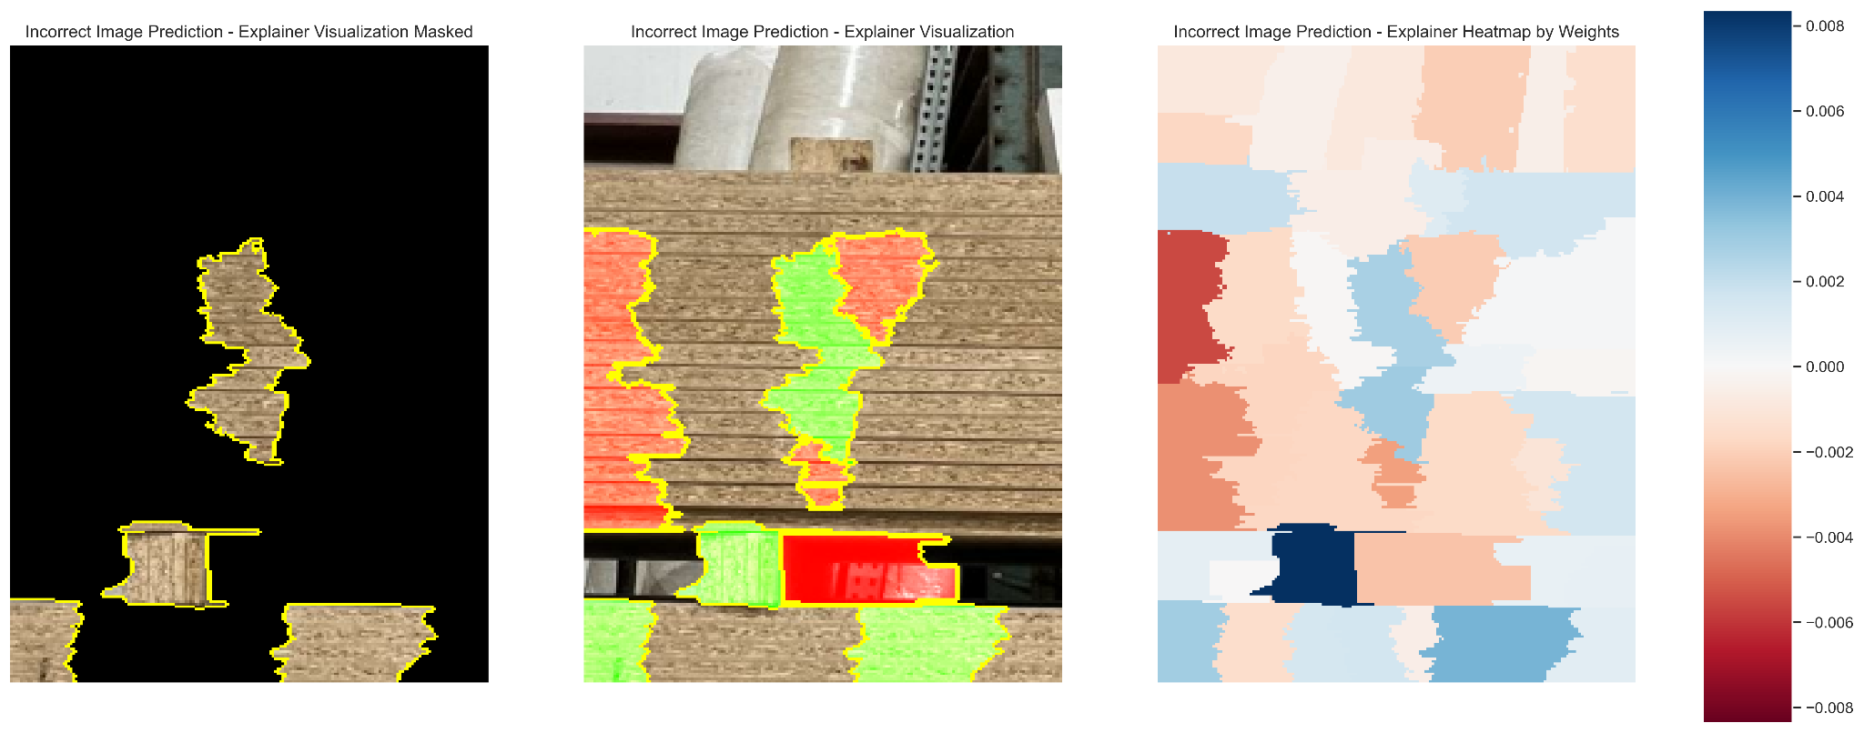
Data
True label: PC
Predicted label: TFL
Picking up on Background
Picking up on other materials

Slide 9
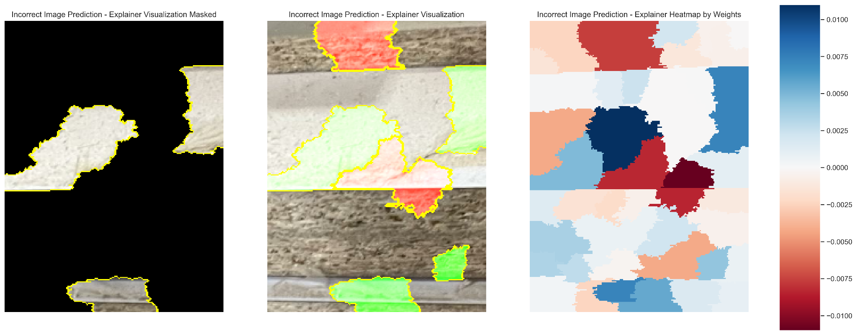
Data
True label: TFL
Predicted label: VC
Dust

Slide 10
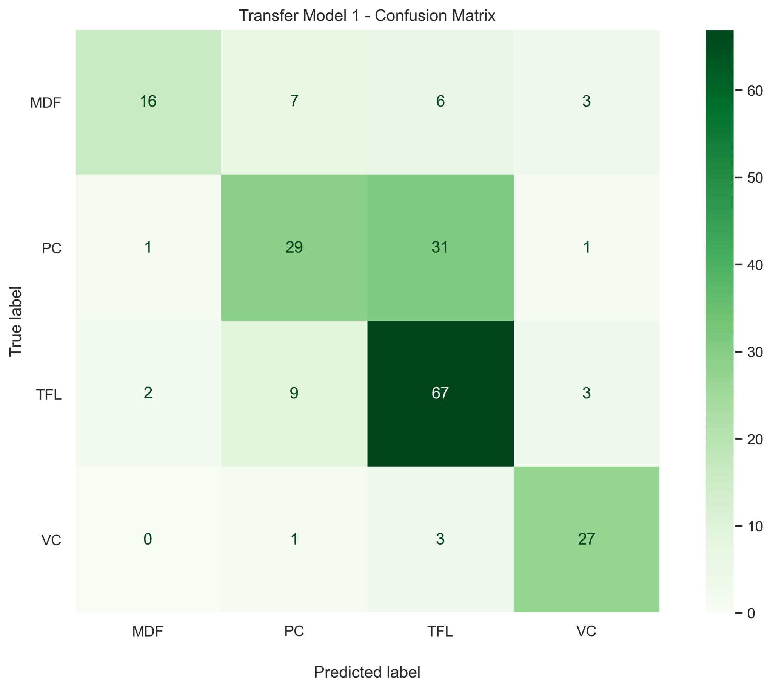
Results
Metrics
Total of 210 items in test set
Overall Average Accuracy at 67%
TFL has the most false positives
PC has the most false negatives
Notes:
Explain confusion matrix
Predicted label on the bottom, true label on the side

Slide 11
Conclusions
Background and dust in images caused noise in classifying images
Difficulty predicting the difference between TFL and PC
Multiple materials in one image created issues in correct predictions
Even with inconsistent data, we were able to come close to required 70% accuracy at the final model’s 67% accuracy
Checks required for the initial production testing period

Slide 12
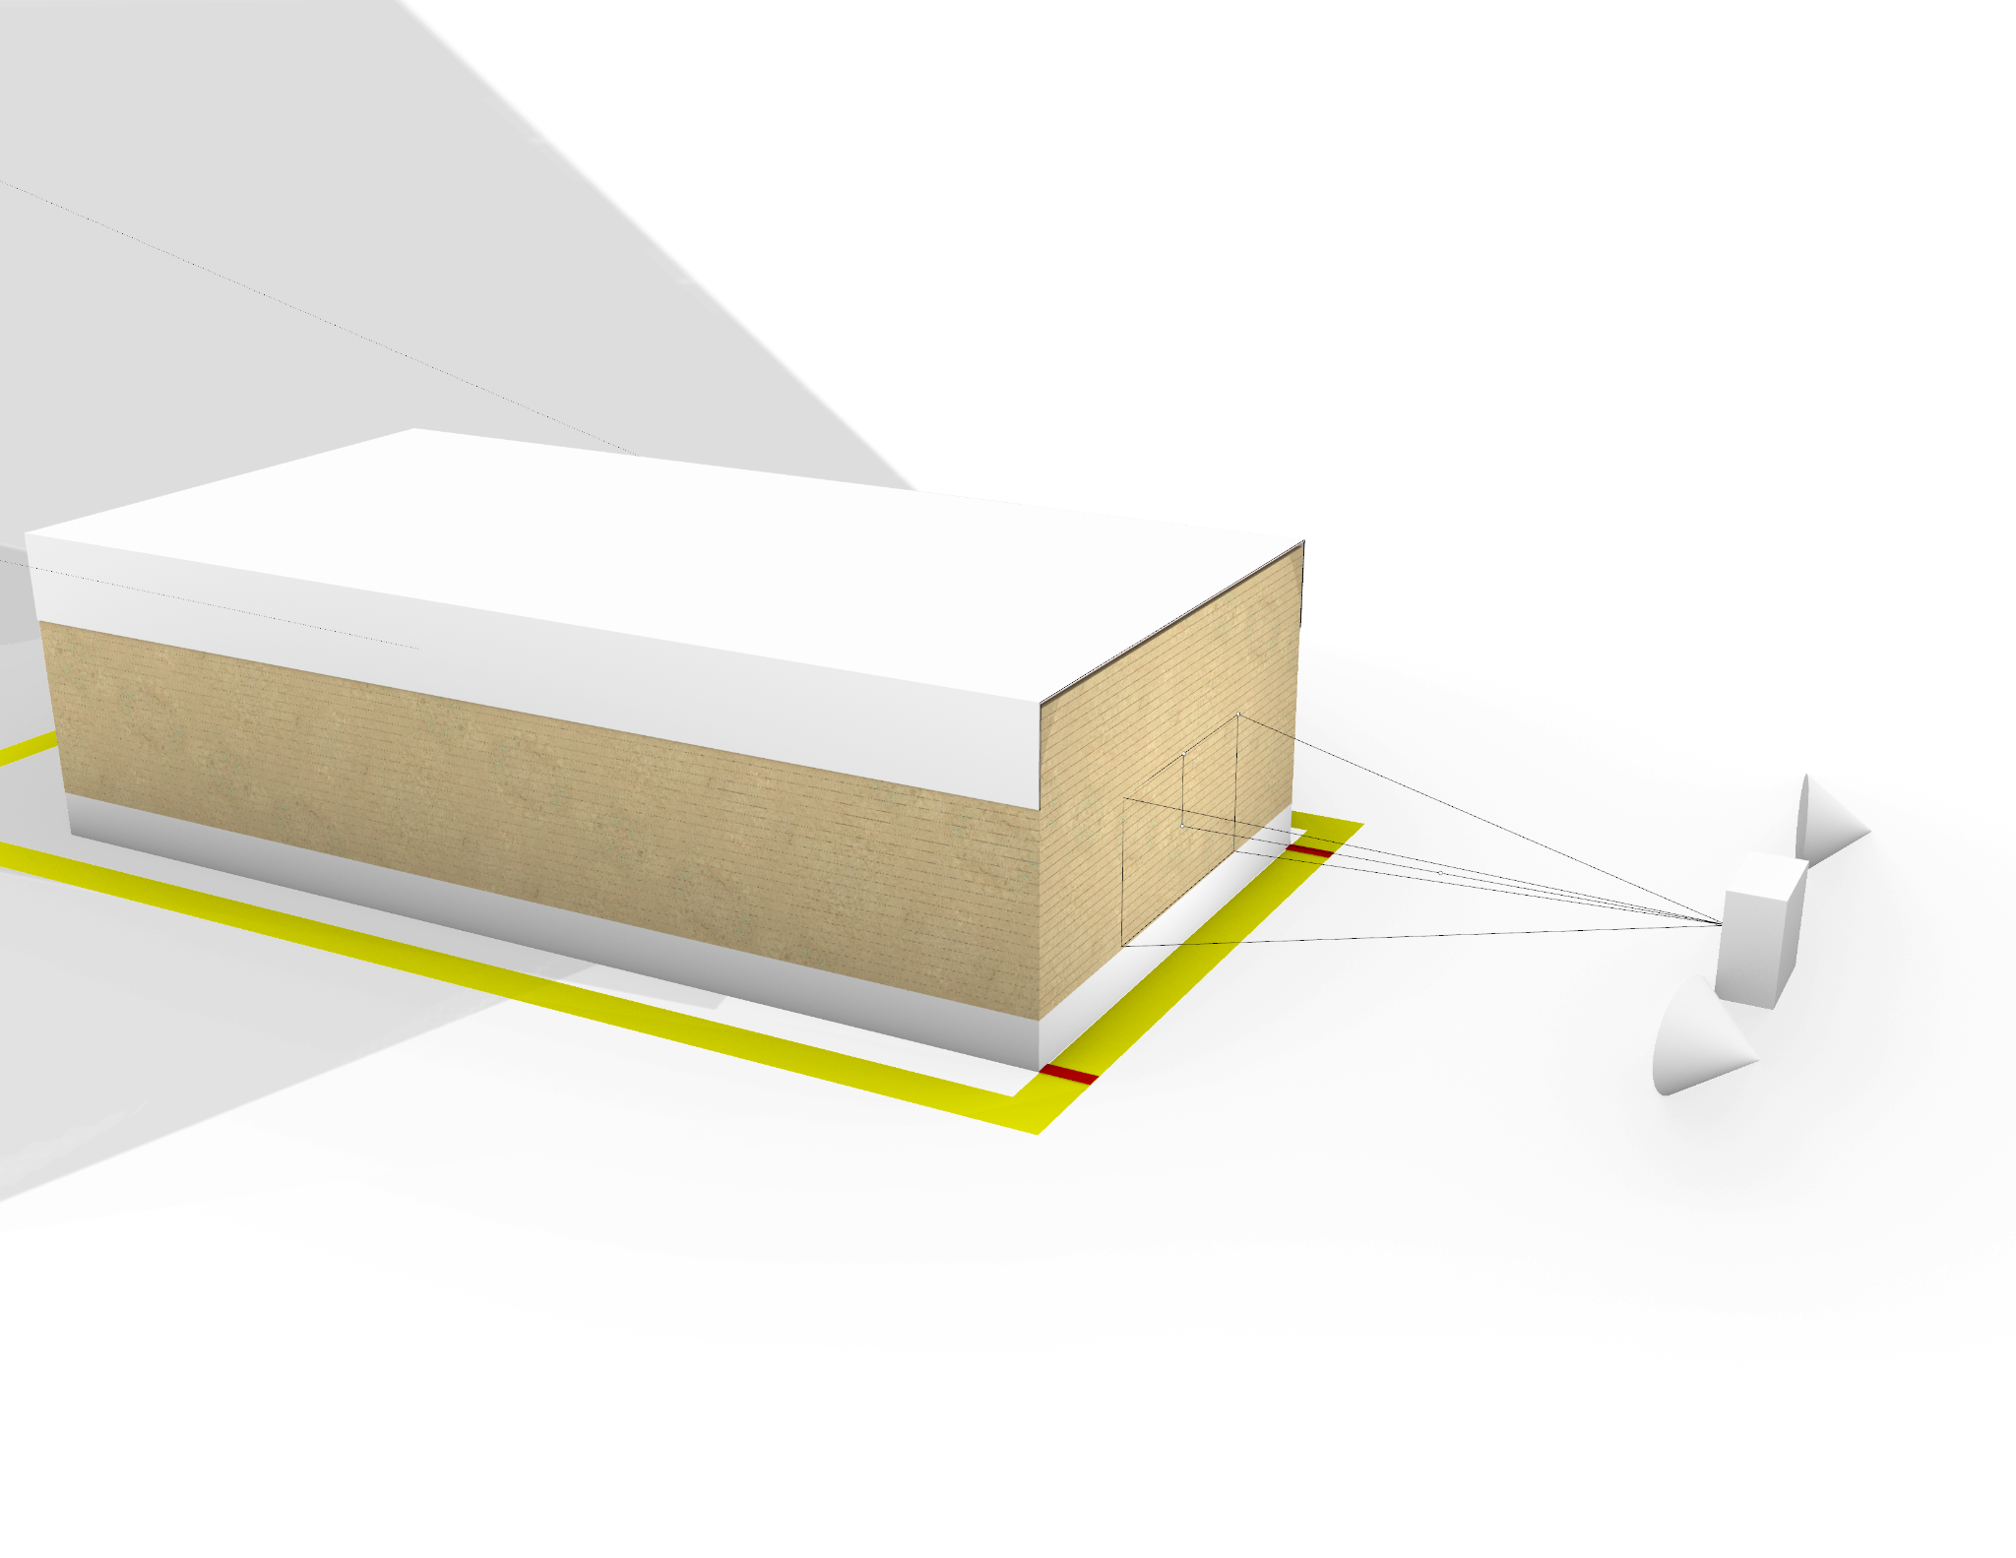
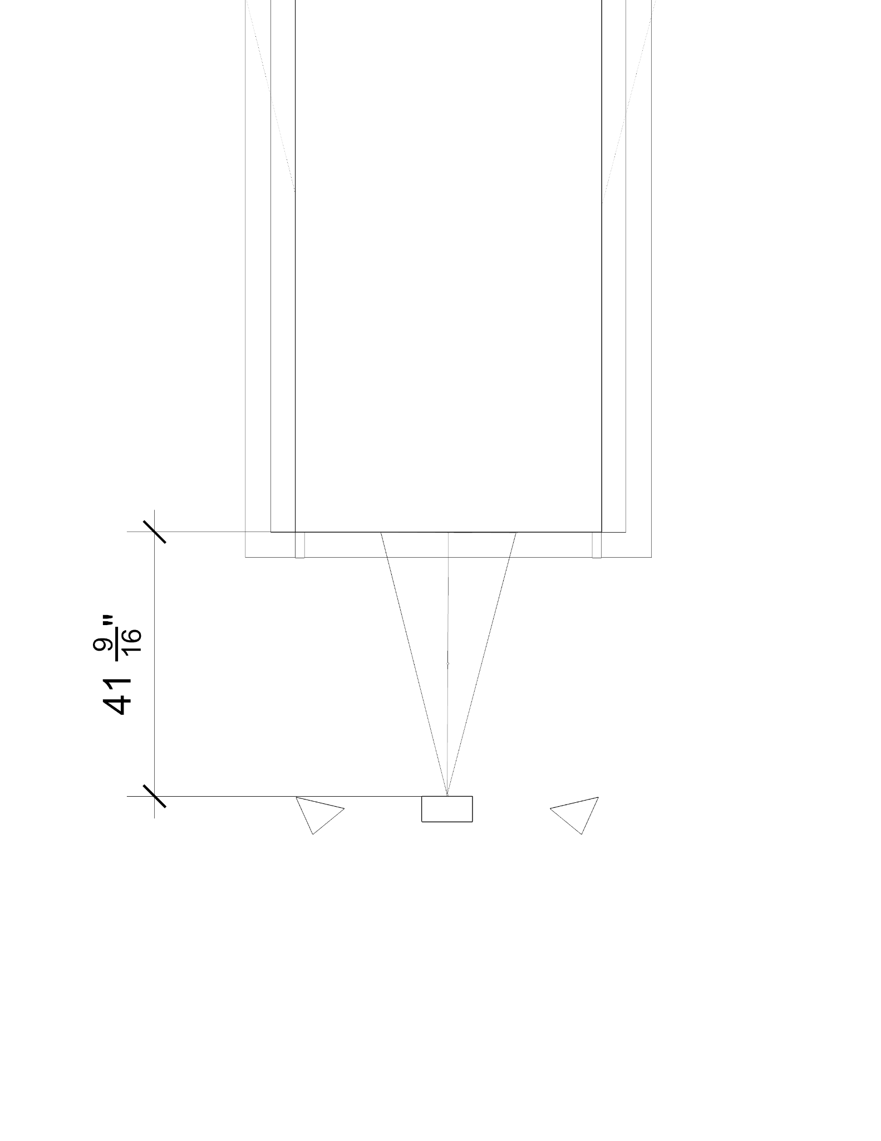

Recommendations - Data - Warehouse Setup
Camera on Tripod
11” High
Backdrop Paint/Laminate black
Two light sources
Work area indicated on floor
Notes:
a. Section off a 5' x 10' area with a rectangle of floor tape and indicate where a 4' wide stack and 5' wide stack should be placed with a line on the floor, in order to center those stacks with the camera.
b. Place a mounted camera on a tripod locked to the ground to capture images of the short side of the material stack.
b. On the same side as the camera, warm even light (from ideally two light sources each on either side of the camera) should be pointed at the short side of the material stack.
c. The camera should be mounted as close to the material as possible while also being out of the working area so as to not be hit by people or material. In this case, the optimal positioning is 3'-6" away and 11" high so that it can capture both full stacks and partial stacks of incoming material.
d. On the opposite side of the camera, place a blank backdrop (a blank solid colored wall) to prevent noise in images should the camera be taking picutres of partial stacks of received material.

Slide 13
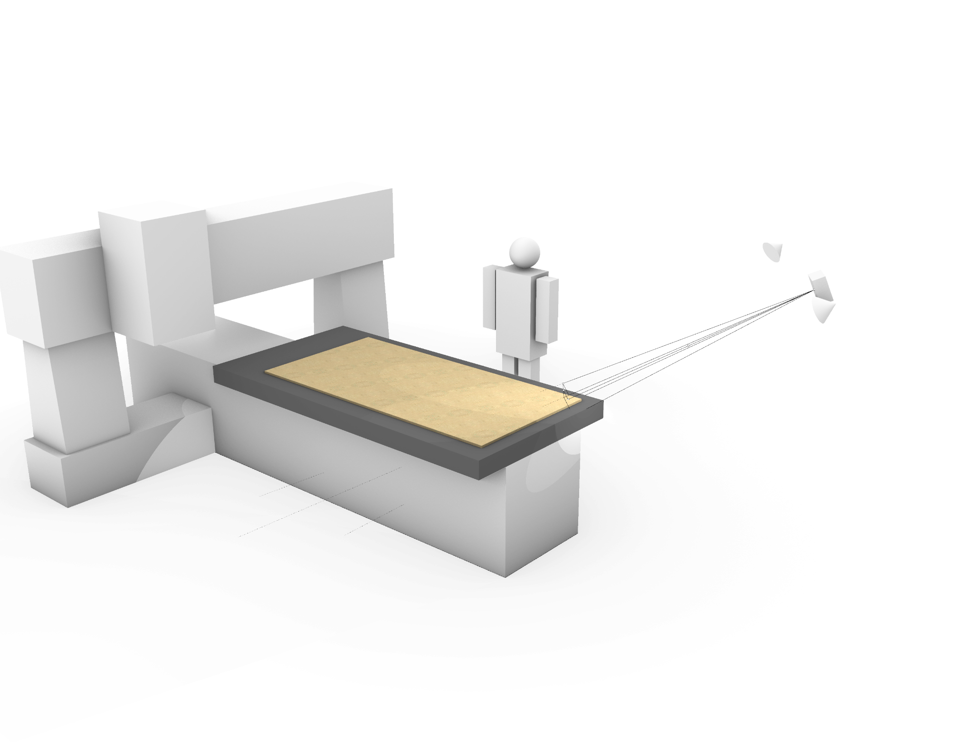
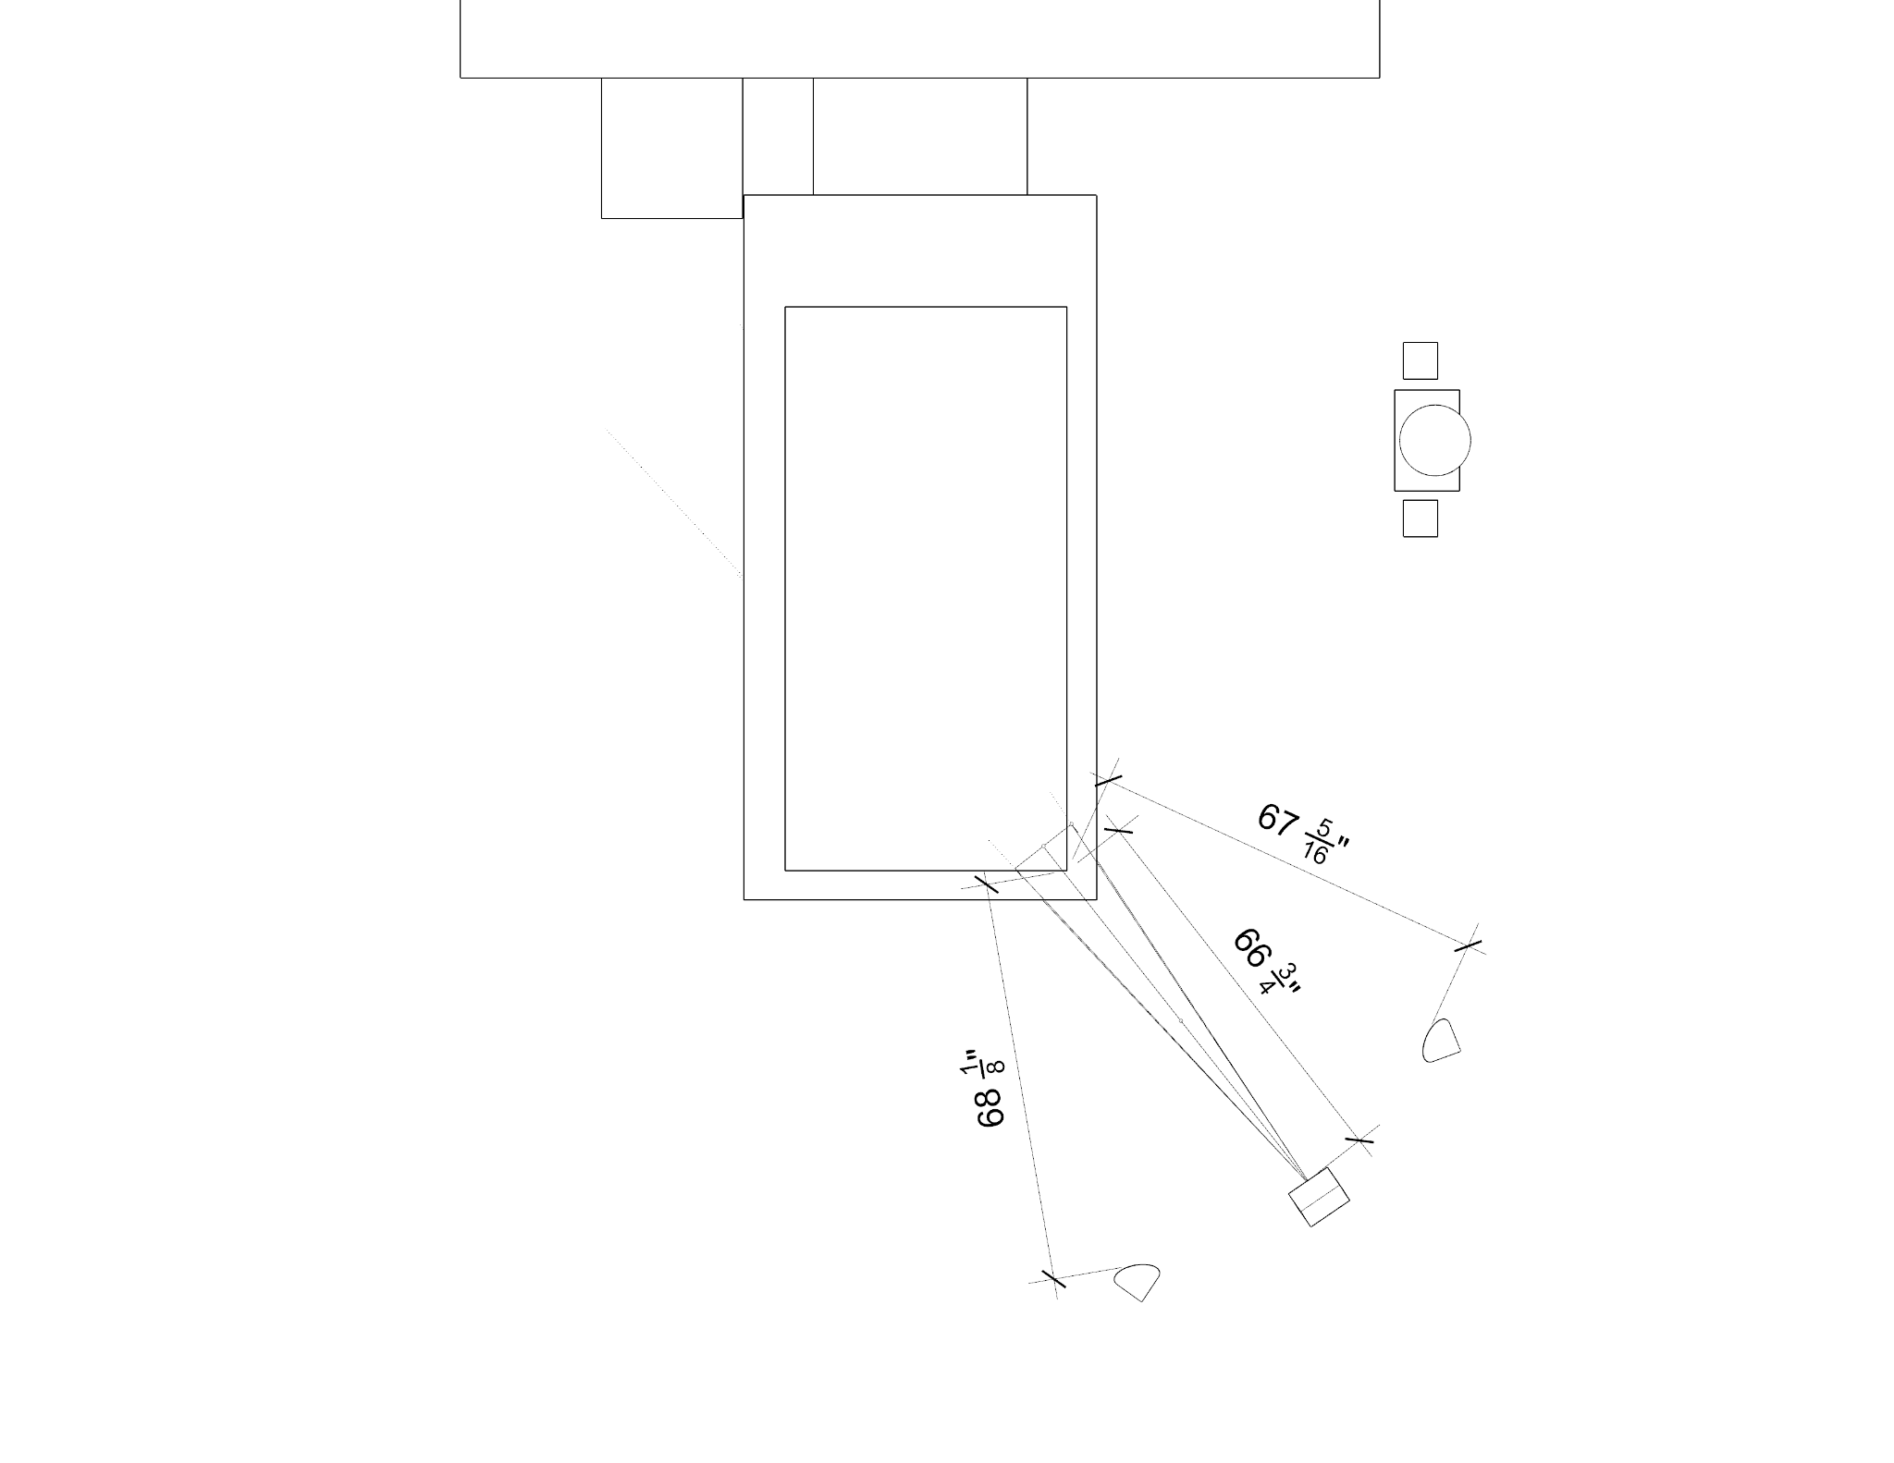
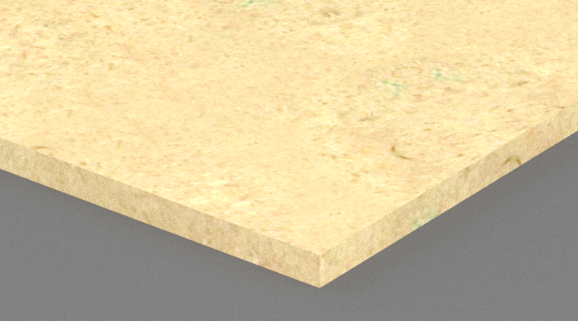
Recommendations - Data - CNC Setup
Camera Hung
7 ft High
Background Paint/Laminate black
Two light sources
Material at 0,0 on CNC
Notes:
a. The camera should be mounted as close to the material as possible while also being out of the working area so as to not be hit by people or material. Hang mounted camera about 9 ft diagonally from corner of material and 7' in the air, pointed towards material corner at the origin on router when the router is homed.
b. Any other surfaces in the camera frame should be painted or laminated a solid black color to prevent noise.
c. Two light sources should be hung next ot he camera pointed at the material to disperse warm even light on the material.

Slide 14
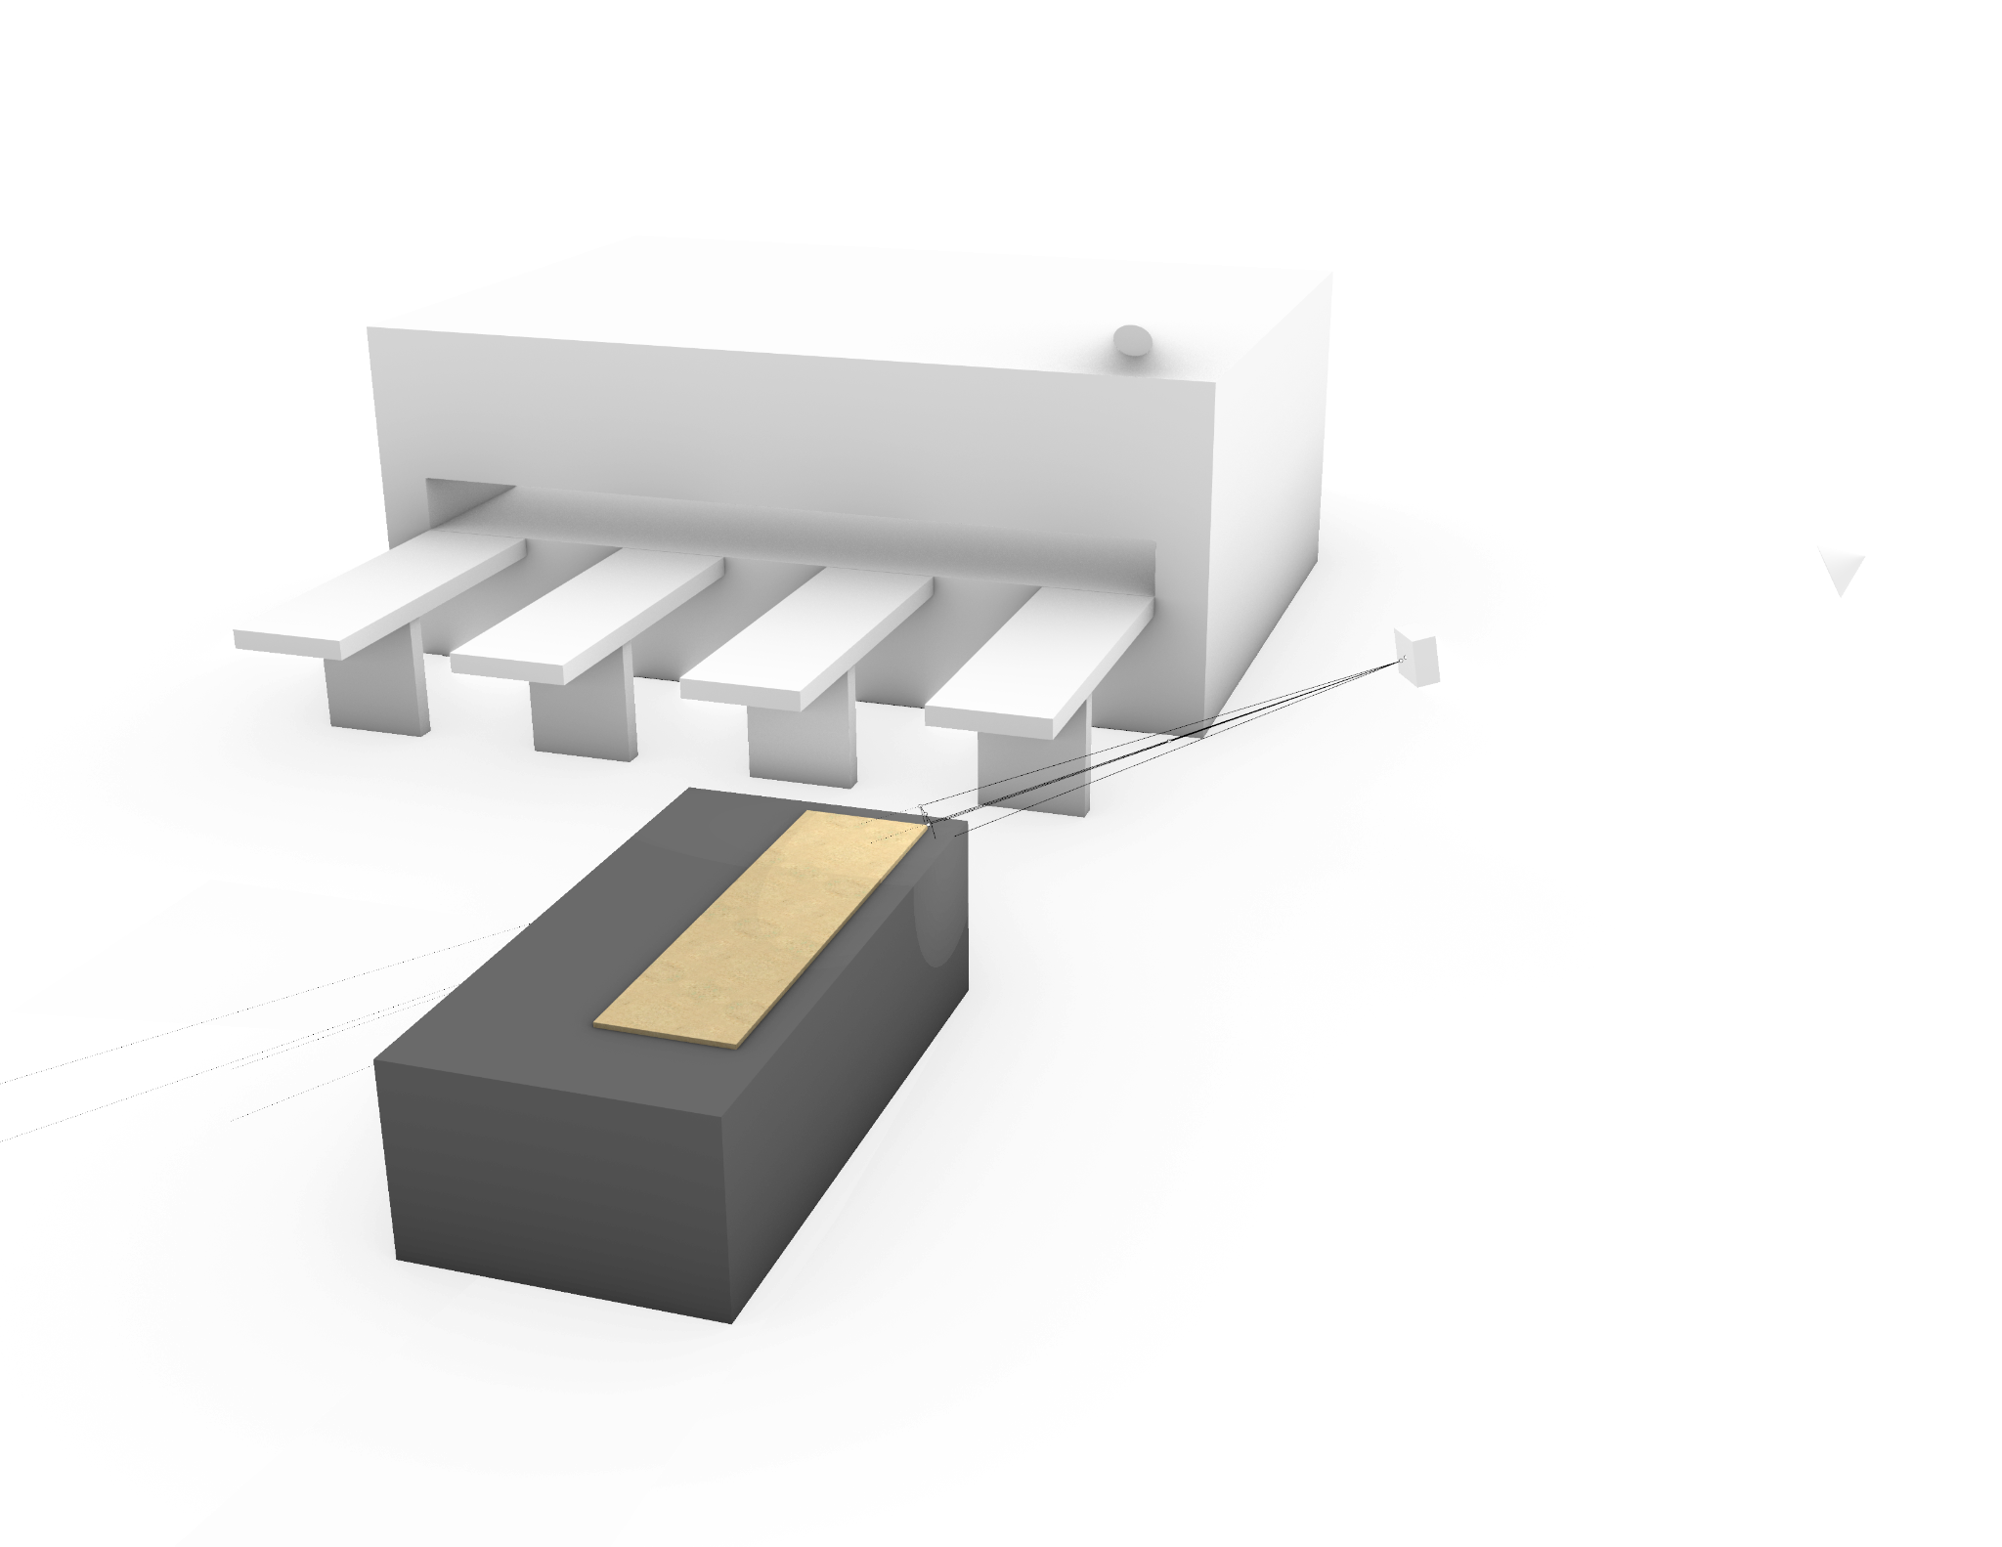
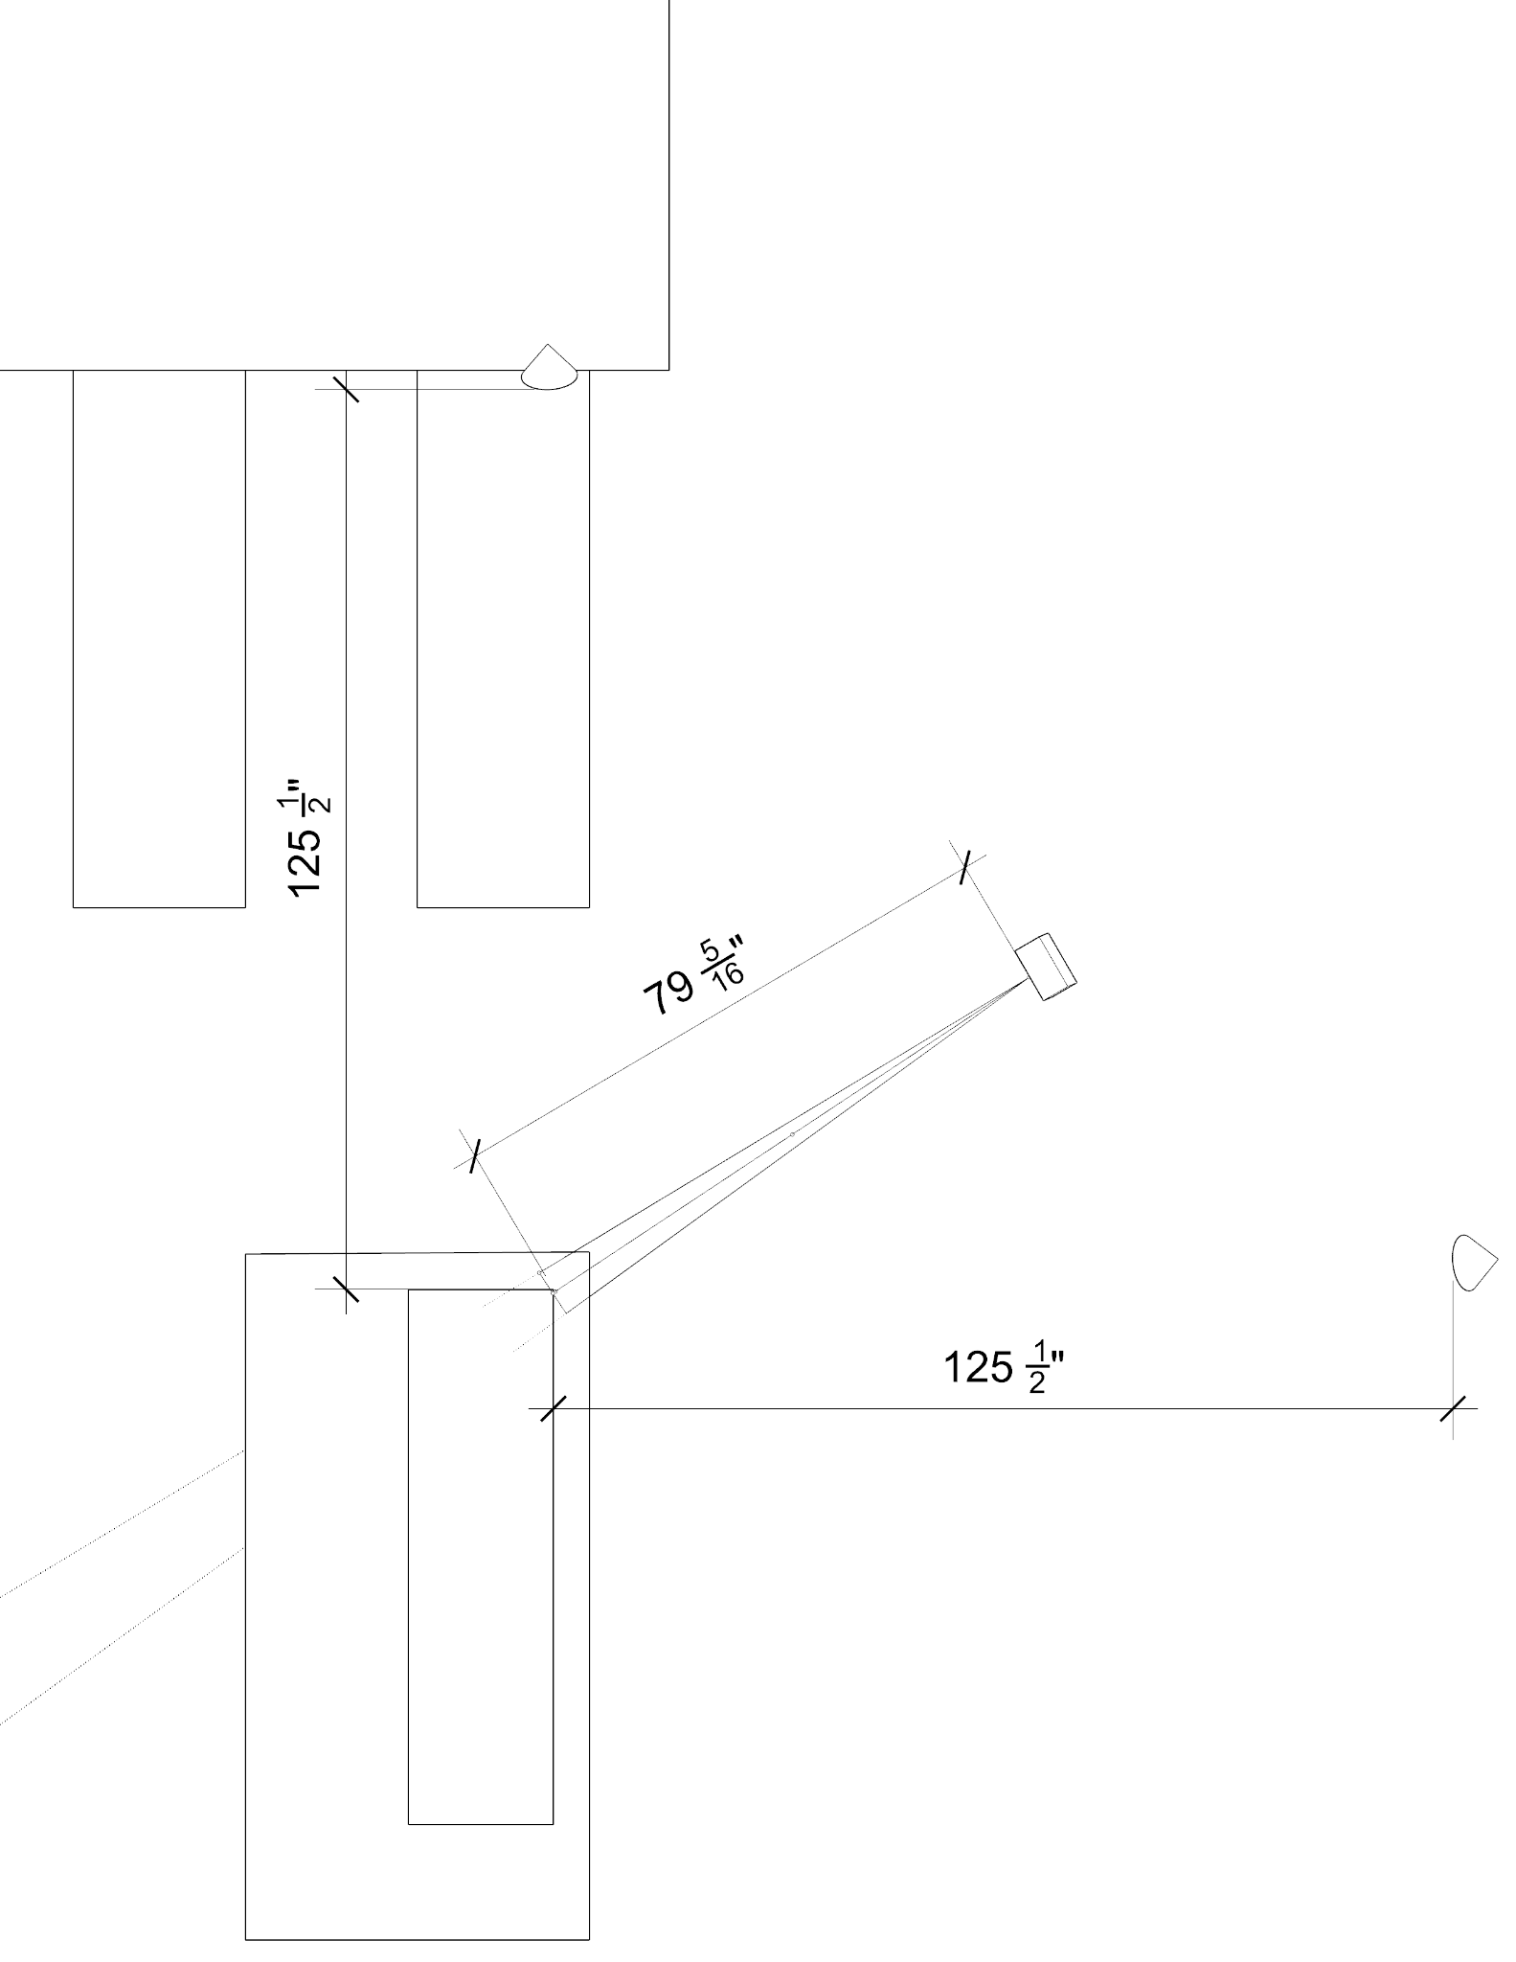
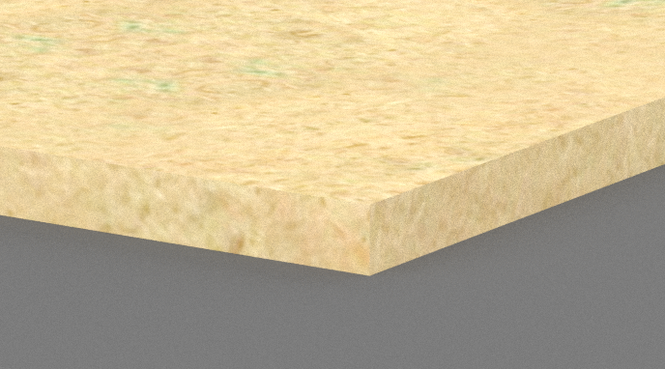
Recommendations - Data - Panel Saw / Scrap Rack Setup
Camera Hung
7 ft High
Background Paint/Laminate black
Two light sources
Material corner placement on table
Notes:
a. A standing height work surface should be setup close to the panel saw to accept scrap cuts that vary up to 5' in width and 10' in length. This work surface should be painted or laminated in one solid color.
b. The camera should be mounted as close to the material as possible while also being out of the working area so as to not be hit by people or material. A camera should be hung from the ceiling at about 7 ft high and 9 ft away diagonally to capture the corner of the material.
c. Two light sources should be hung next to the camera pointed at the material to disperse warm even light on the material.

Slide 15
Recommendations - Implementation
Model can be implemented immediately with human assistance.
Worker can check prediction on a tablet and correct if the prediction is incorrect.
Human oversight should take place for 90 days after implementation.
After which accuracy will be assessed again.

Slide 16
Next Steps
1
2
3
Increase amount of data to train on by gathering 10,000 or 20,000 images
Parse image data of product labels for incoming skids of material in the warehouse to provide a more accurate prediction
Better accuracy could be obtained by fine tuning and iterating on the final model

Slide 17
THANK YOU

Slide 18
APPENDIX

Slide 19
Background
Material Handling
The movement, protection, storage, and control of materials and products throughout manufacturing, warehousing, distribution, consumption and disposal
Retail Store Fixture
Any piece of equipment or furniture used to display products. The most common type of fixture are shelves, but there are countless types of fixtures like mannequins, display racks, display cases, stall walls, signage holder, and more.
Notes:
Robot that can retrieve panels from a storage area
Gantry
Robot arm
Hardware comes with a software end but this requires human input which they want to avoid
So they need the software side to automatically recognize material required

Slide 20
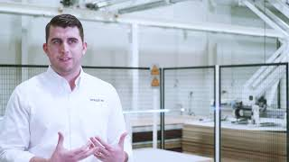
Background
Madjek Inc (a fixture manufacturer) would like to purchase a Panel Storage and Retrieval System to control material handling
Notes:
Robot that can retrieve panels from a storage area
Gantry
Robot arm
Hardware comes with a software end but this requires human input which they want to avoid
So they need the software side to automatically recognize material required

Slide 21
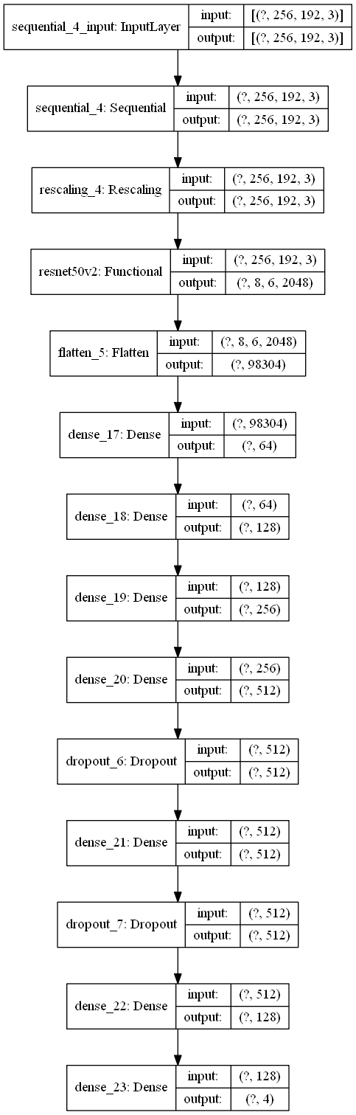
Data

Slide 22
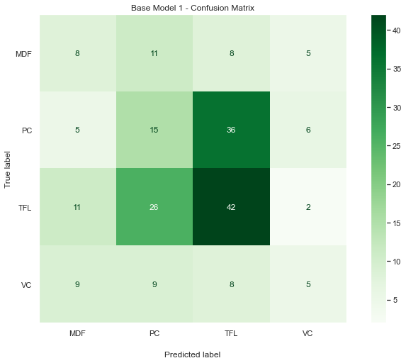
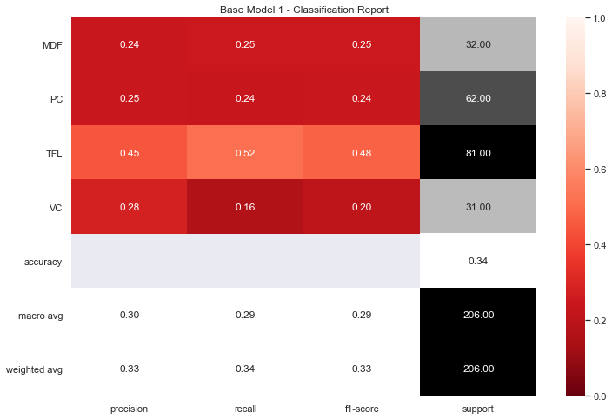
Data
Misprediction between TFL and PC. Widespread mispredictions
Low values in all metrics

Slide 23
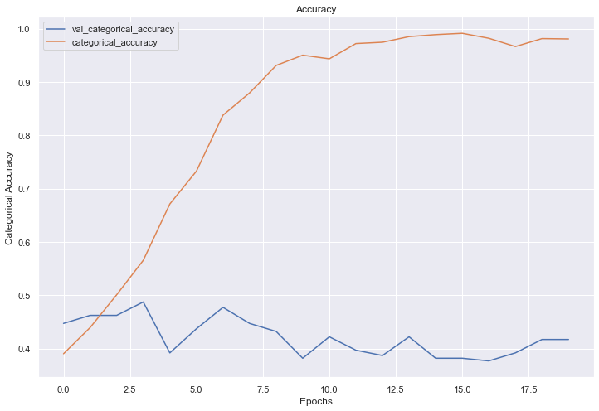
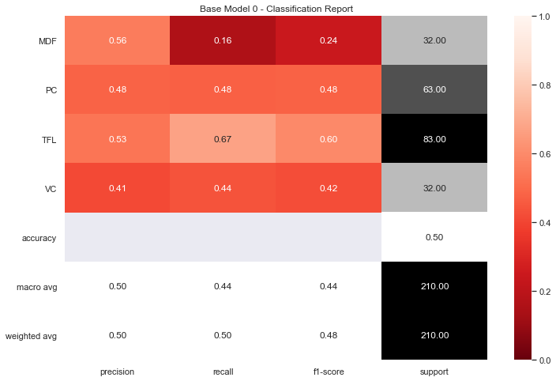
Data
Accuracy Overfitting in Base Model
Accuracy almost equal to percentage of TFL items

Slide 24
Data
Widespread incorrect predictions
Incorrect predictions between TFL and PC

Slide 25
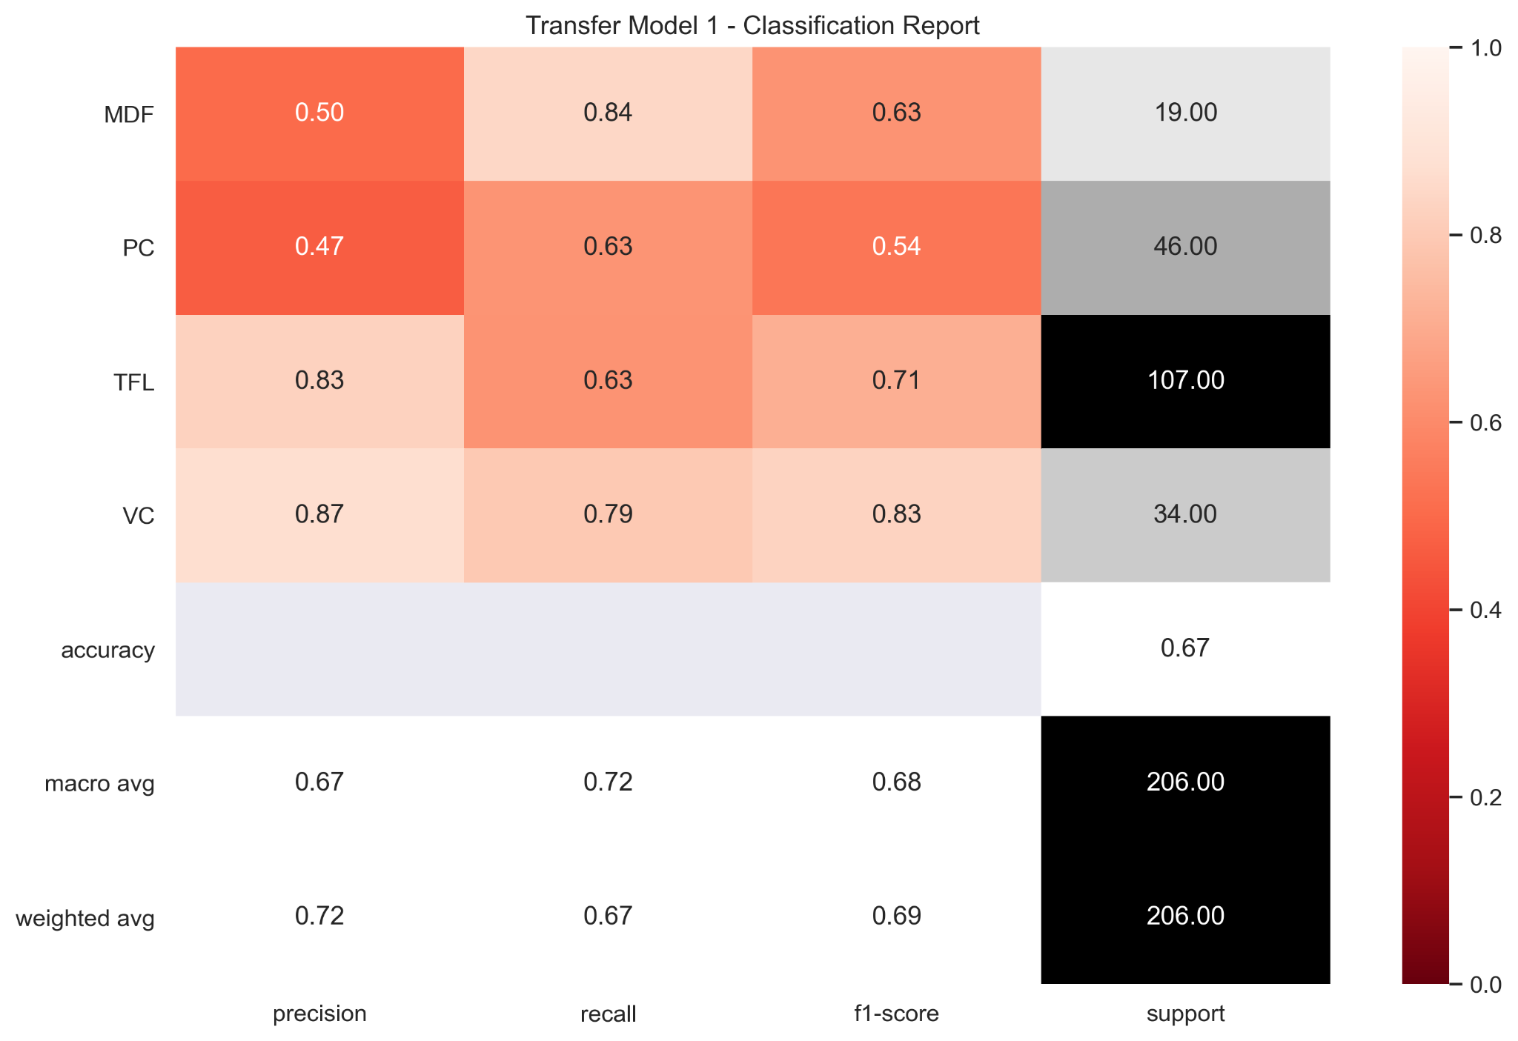
Data

Slide 26
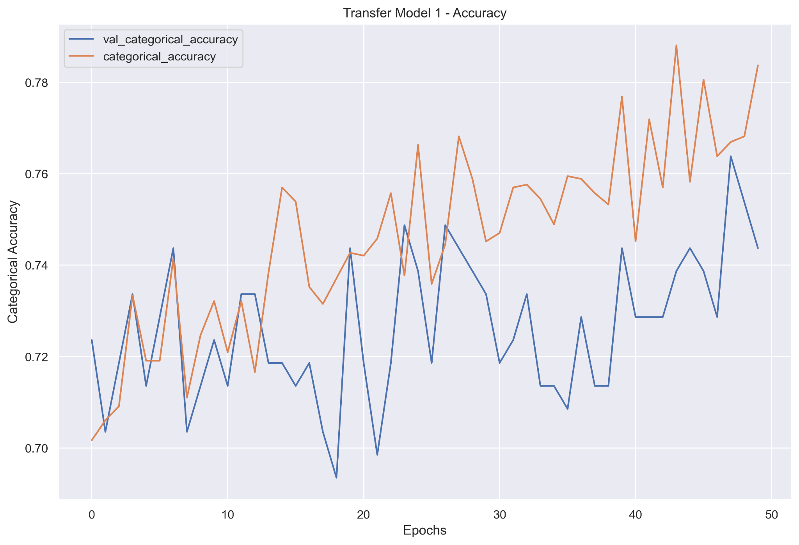
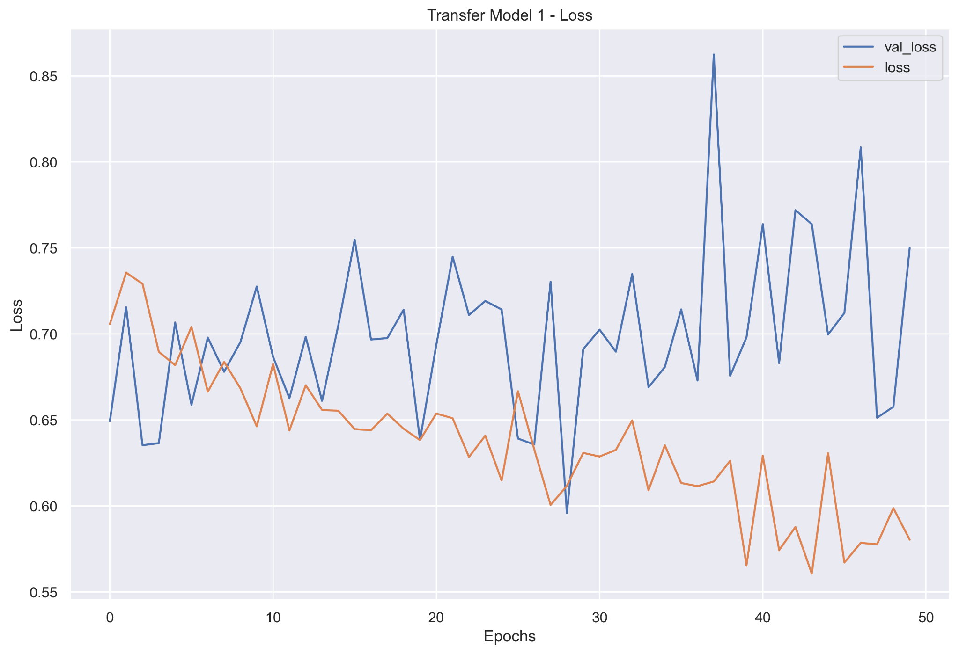
Data
Accuracy continuously increasing over epochs and loss decreasing over epochs.

Slide 27
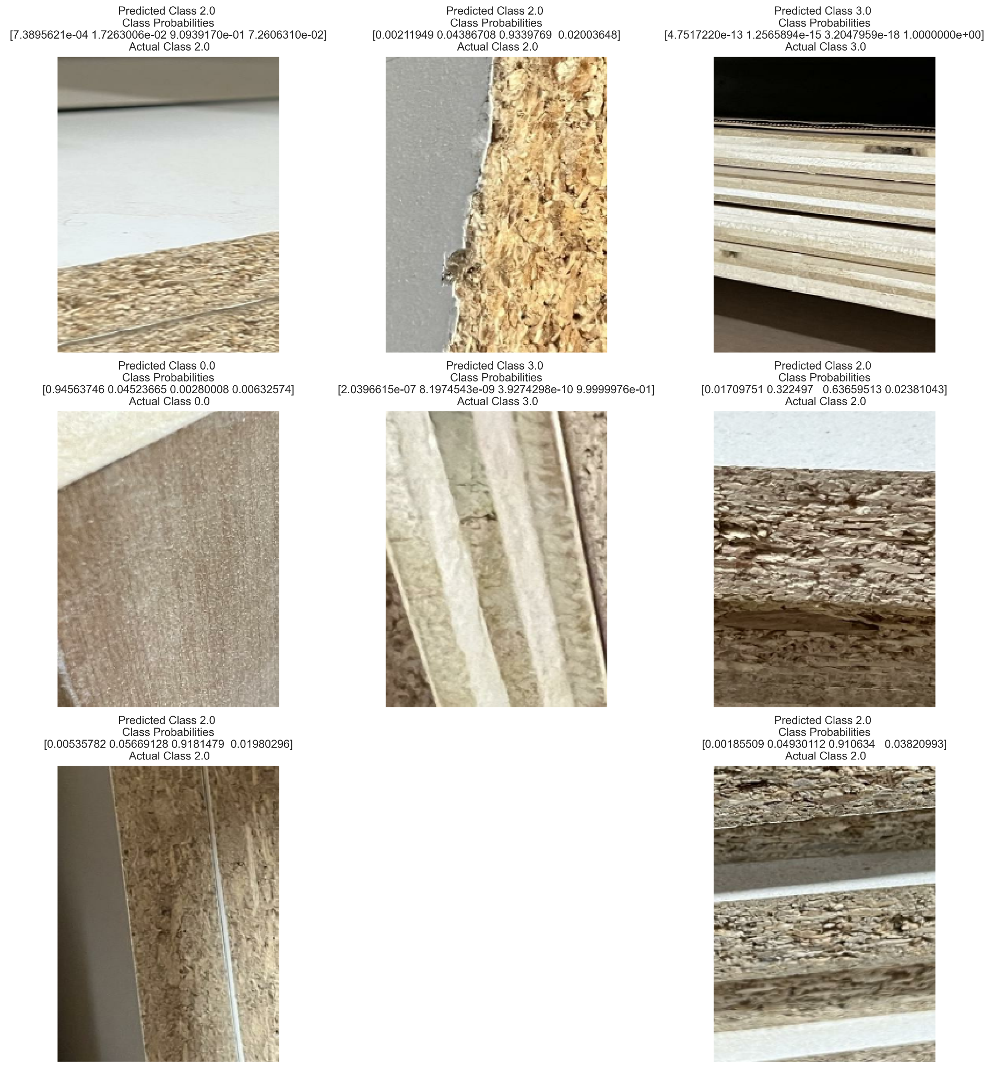
Data - Correct
Correct images show material or similar stacks of materials taking up the whole image frame

Slide 28
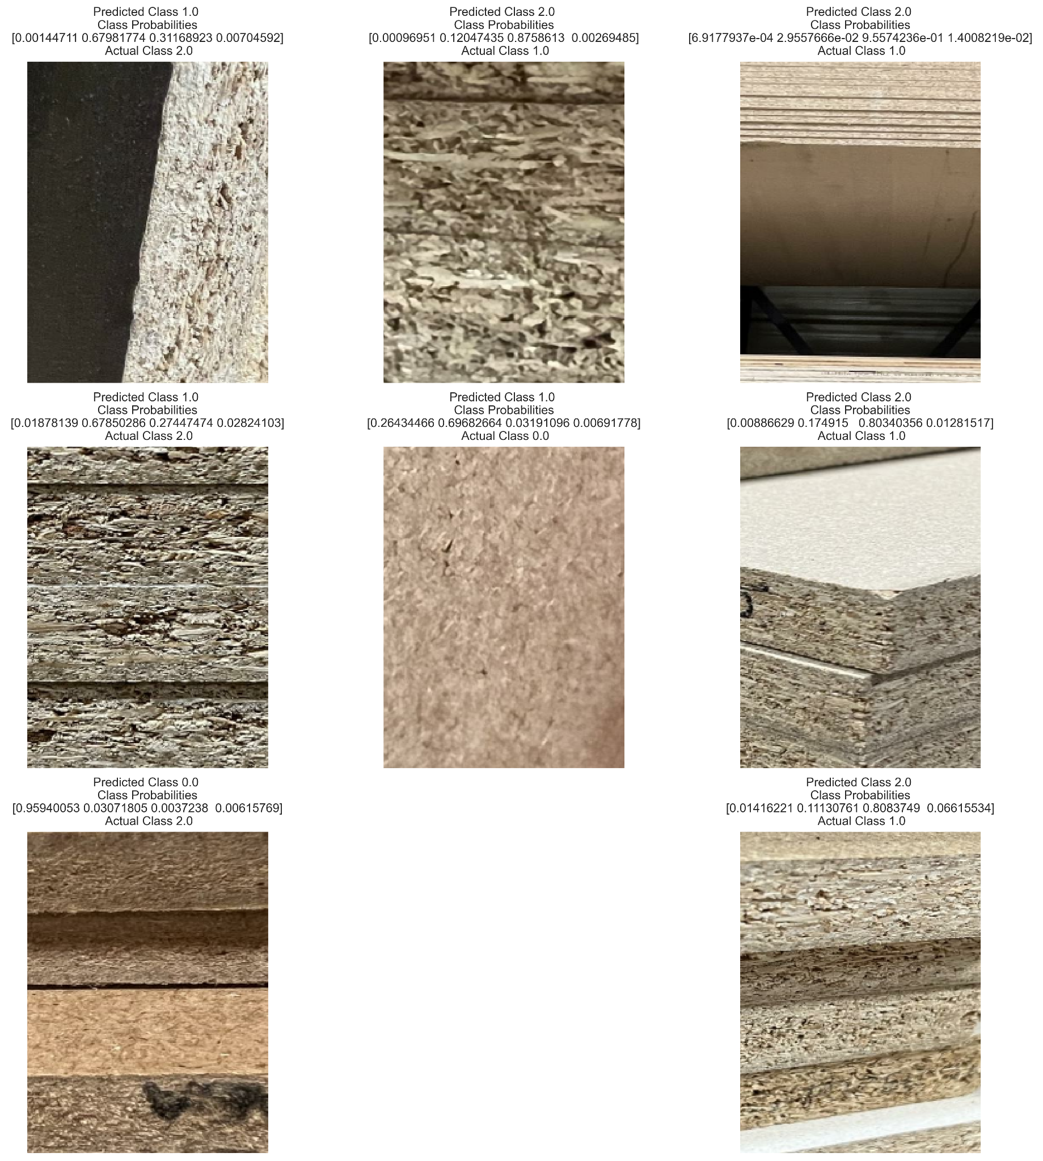
Data - Incorrect
Incorrect images show images which have varied issues to be dealt with:
1 - Black TFL not common
2 - Image too close
3 - Image too far away
4 - Image too close
5 - Image too close
6 - Lighting makes material appear to be white TFL
7 - Incorrectly labeled
8 - Other materials in frame
1
2
3
4
5
6
7
8

